Slide 1
My retail sector

Slide 2
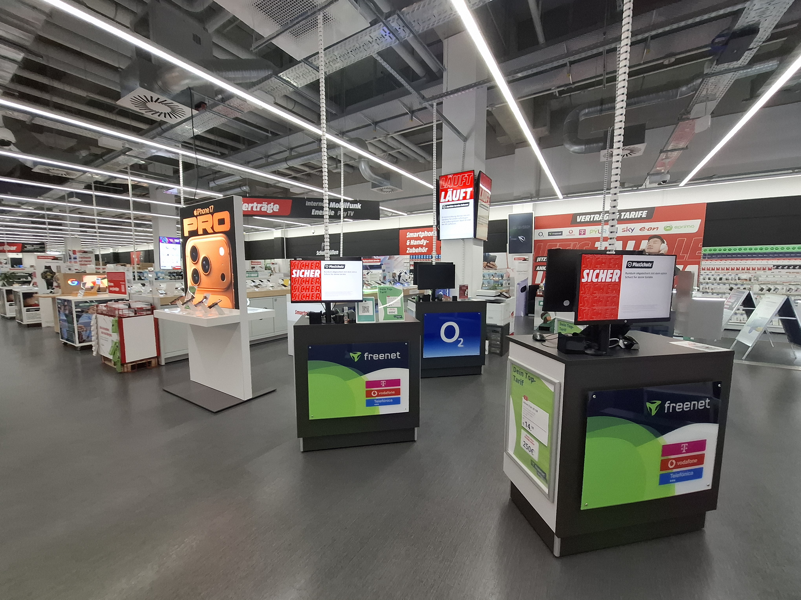
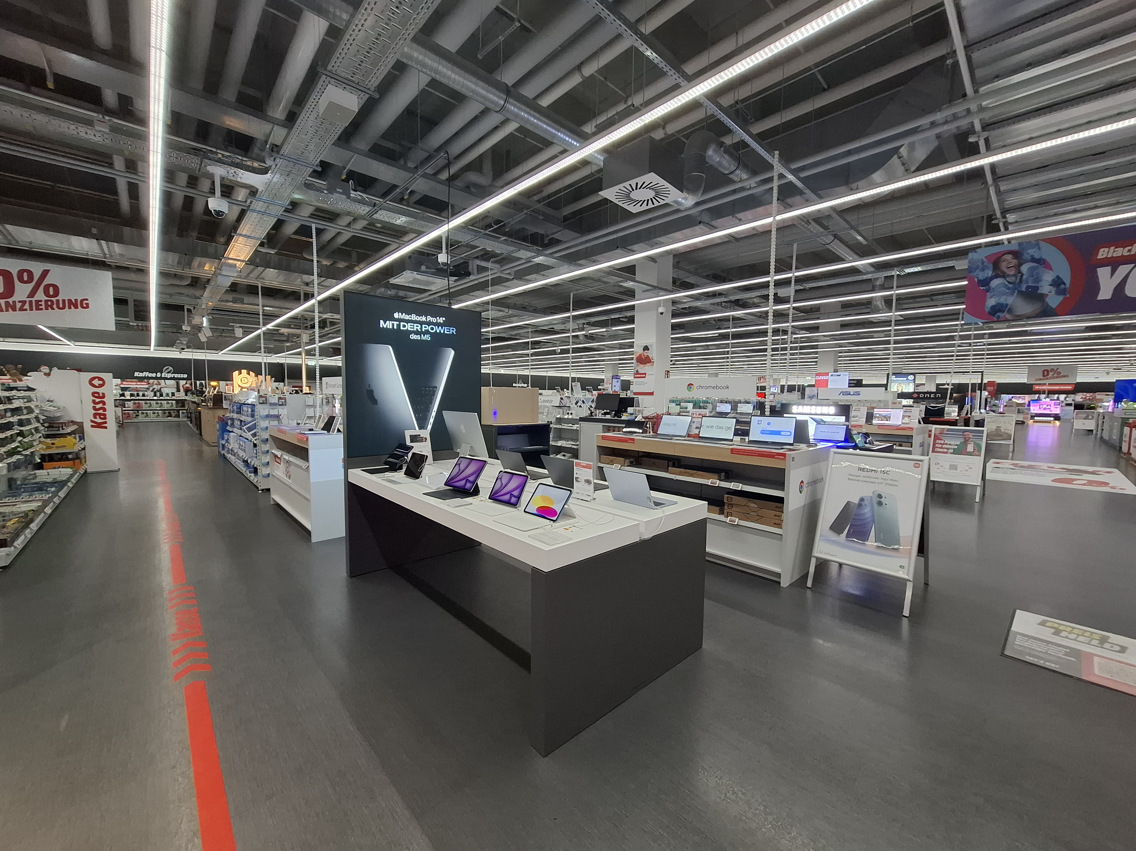
GSM
New Media

Slide 3
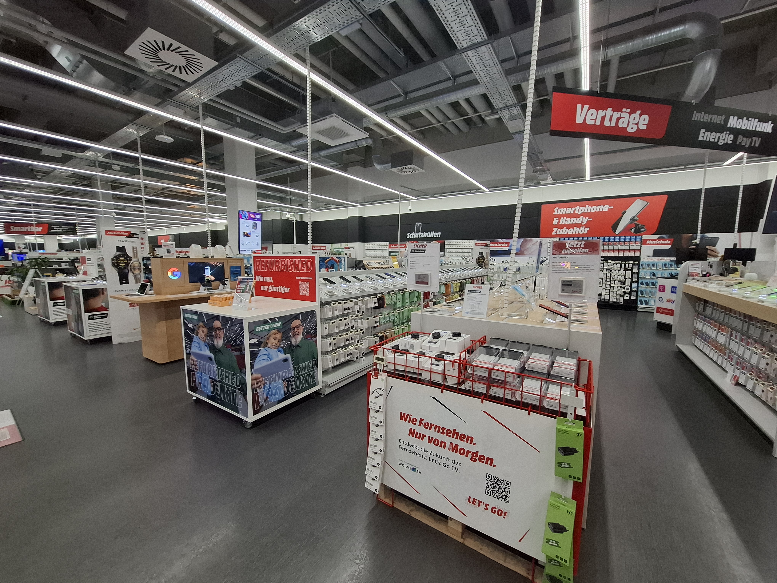
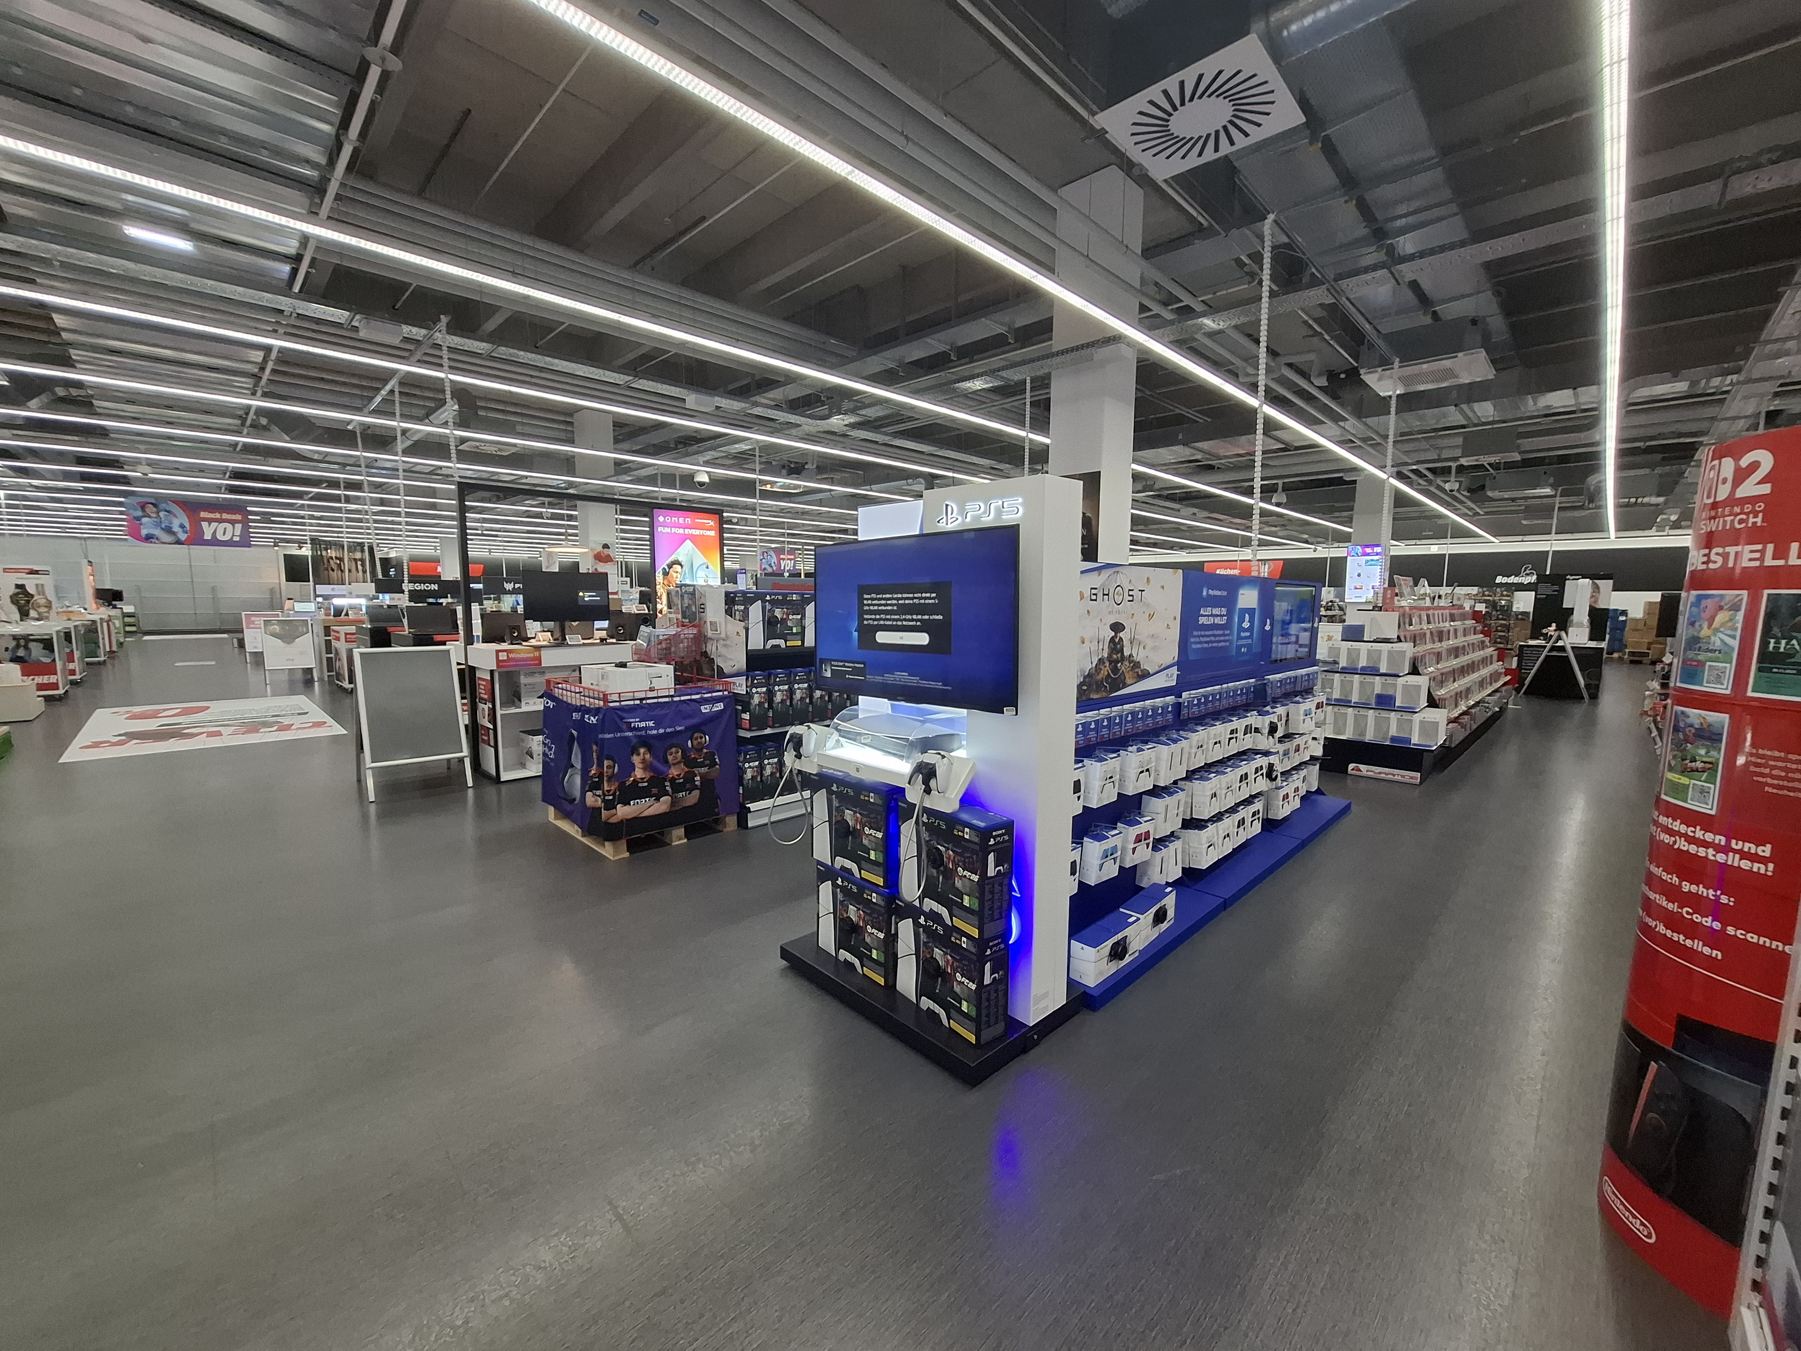
GSM:
Global System for Mobile Communications
The GSM section at Media Markt includes all products and services related to mobile communication technology, especially smartphones and accessories
New Media:
The "New Media" section at Media Markt includes products and technologies related to modern digital media and communication. This includes tablets, laptops, smartwatches, as well as streaming devices

Slide 4

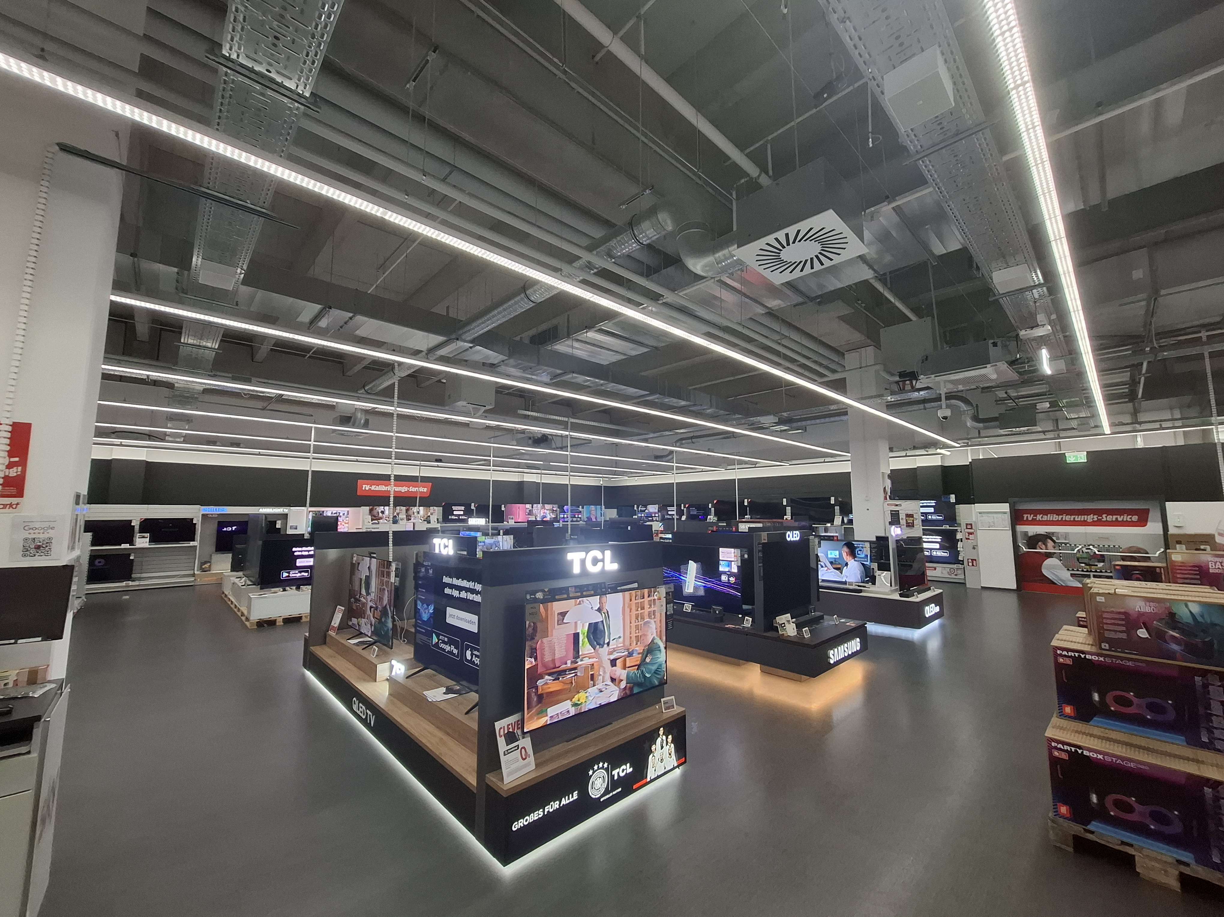
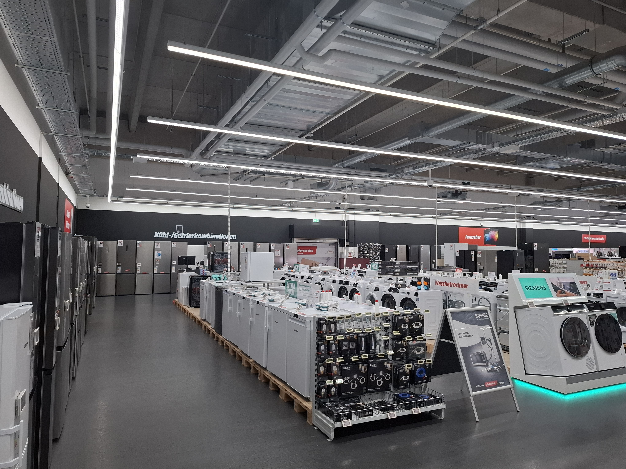
Brown goods
White goods

Slide 5
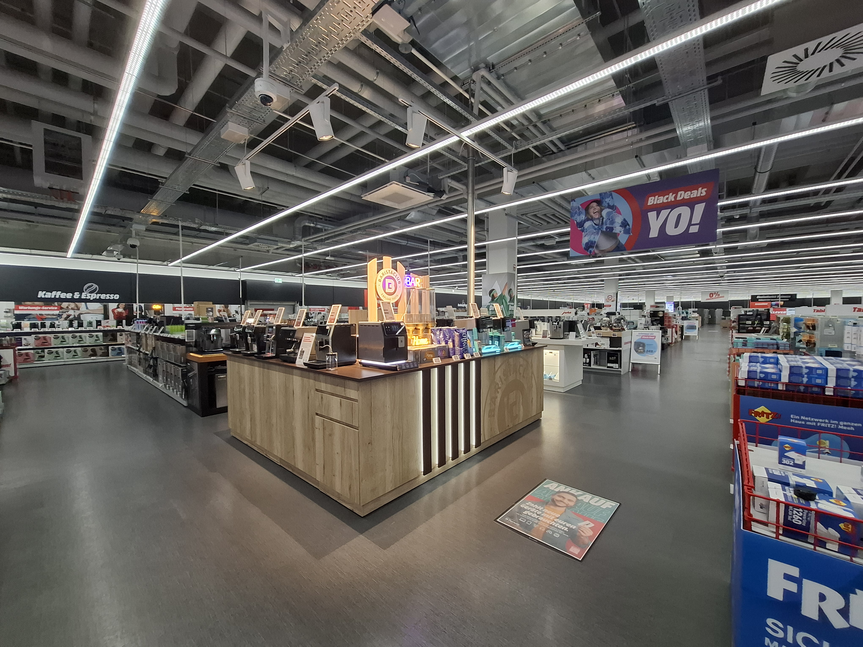
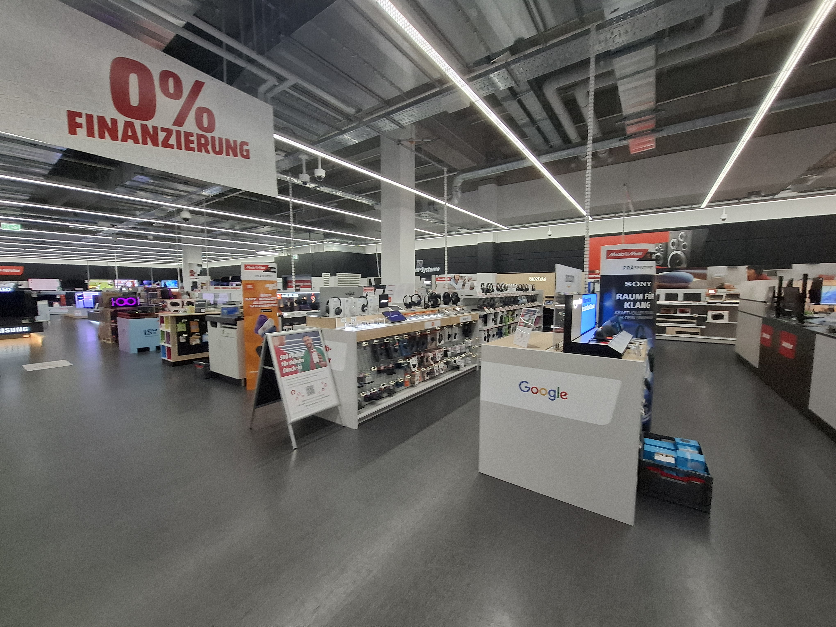
White Goods:
Major home appliances.
The "White Goods" section at Media Markt
includes large household appliances.
This category includes refrigerators, washing machines, dryers, ovens, dishwashers, and microwaves.
Brown Goods:
Consumer electronics and entertainment devices.
The "Brown Goods" section at Media Markt includes
consumer electronics and home entertainment products.
This includes TVs, sound systems, stereos and video players.

Slide 6
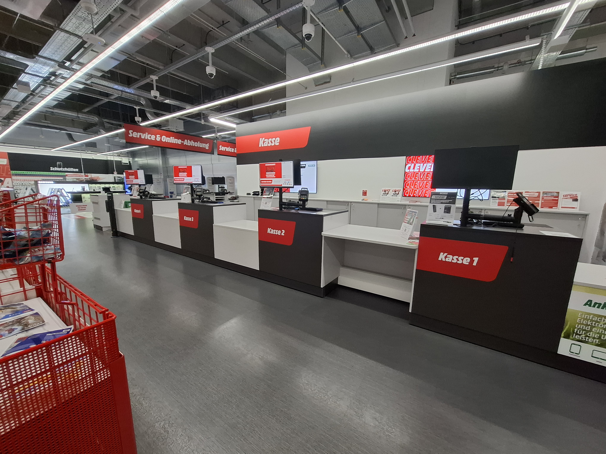
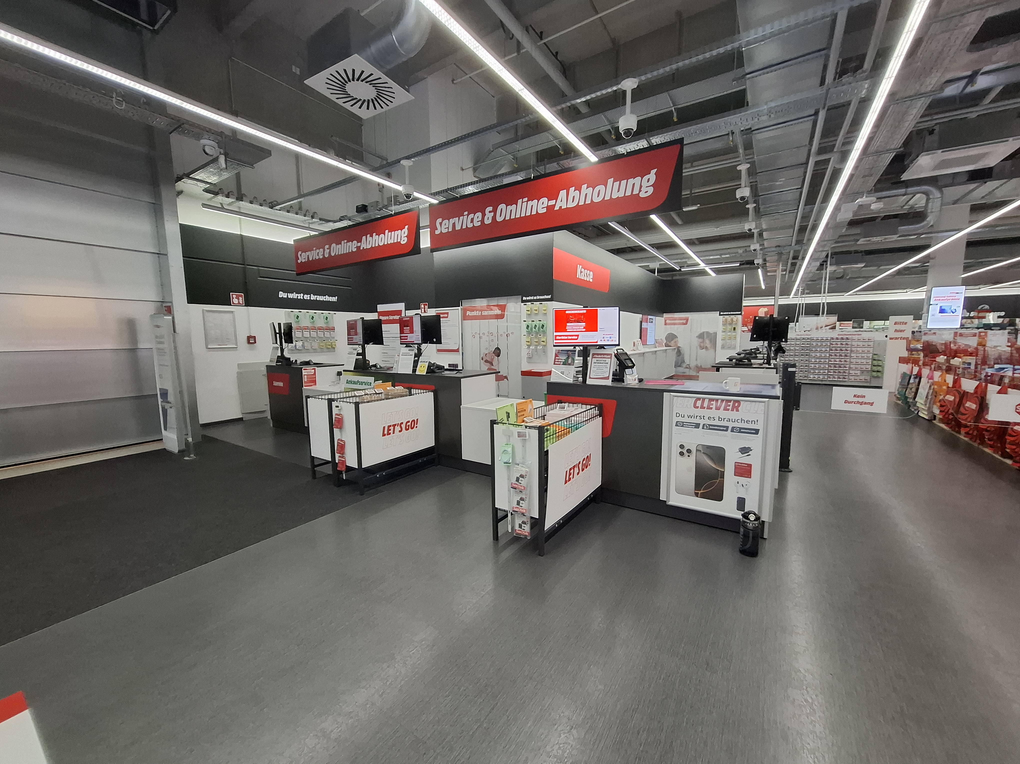
Checkout And Service

